Slide 1


“Chemical Resistant Masonry: Refractory and Ceramics”
- Is there a difference?

Slide 2
The intent of the presentation is threefold.
First is to educate the newer members and newcomers to the industry on the often incorrectly used descriptions of the two lining systems. The terminology Refractory Lining and Chemical Resistant Masonry Lining are far too often used interchangeably.
Second is to develop an awareness for those users who might not appreciate the different knowledge and skill sets required for installing the different materials.
And finally, to highlight the efforts of the two MTI projects currently underway, the availability of the two new resources and the possibility for future work.

Slide 3
What is a refractory lining:
A refractory lining is a protective, heat-resistant layer of materials like bricks, castable, or fiber, used to line the interior of high-temperature equipment like furnaces, kilns, and boilers.
Its primary functions are to insulate the equipment, protecting its outer shell from extreme heat and mechanical stress, and to resist thermal degradation and attack from the hot contents inside.

Slide 4
Key aspects of refractory linings
The lining acts as a thermal barrier, preventing heat loss and protecting the vessel's structural shell from extreme temperatures, thermal shock, and corrosive materials.
• Materials: They are made from materials that can withstand high temperatures without melting or degrading.
Common forms include:
• Shaped refractories: Refractory bricks made from materials like high alumina, magnesia, or silicon carbide.
•Monolithic refractories: Materials that can be applied without pre-shaped forms, such as castable, gunning material, or ramming mixes.
•Lightweight/Insulating refractories: Materials like insulating firebricks (IFB) or ceramic fiber blankets, boards, and modules, which provide insulation and reduce weight.

Slide 5
Applications:
Metallurgy: Lining furnaces and vessels for holding and transporting molten metal and slag.
Cement industry: Lining rotary kilns and other vessels.
Chemical processing: Boilers, reformers, and cracking furnaces.
Other: Also used in rocket launch structures and incinerators

Slide 6
Applications:
Metallurgy: Lining furnaces and vessels for holding and transporting molten metal and slag.
Cement industry: Lining rotary kilns and other vessels.
Chemical processing: Boilers, reformers, and cracking furnaces.
Other: Also used in rocket launch structures and incinerators

Slide 7
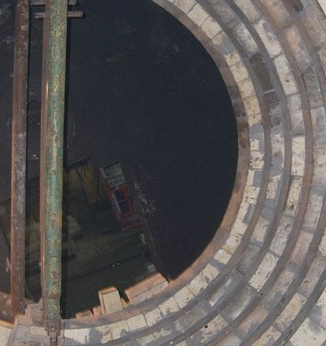
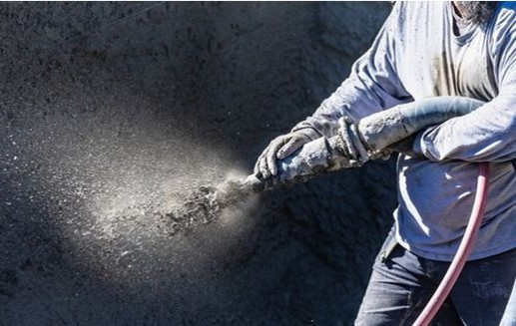
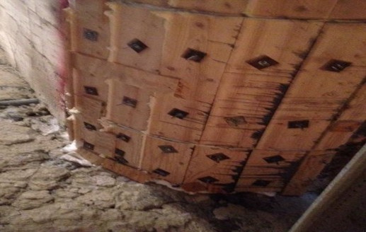
Pictures:
Your paragraph text
Fire Brick / Block
Pneumatically applied sprayed-on refractory
Poured castable with form

Slide 8
What is a chemical resistant masonry lining
A chemical resistant masonry lining is a protective layer of acid-resistant bricks and special chemical-resistant mortars that is installed over a chemical resistant membrane.
Used to line the inside of structures like tanks, vessels, and autoclaves to prevent corrosion from acids and other harsh chemicals.
These linings provide a durable, high-strength barrier that protects the underlying substrate, extending the life of equipment in industries such as chemical processing, steel manufacturing, and mini-industry.

Slide 9
Key features and purpose
Protective barrier: It acts as a barrier between corrosive substances and the structural material (like steel or concrete), in an effort to prevent damage and corrosion to the equipment.
• Corrosion resistance: The specialized bricks and mortars are designed to withstand chemical attack, high temperatures, and other harsh conditions.
• Structural integrity: By preventing corrosion, the lining maintains the structural integrity of the vessel or structure, ensuring long-term durability.
• Versatile application: These linings are used in a wide range of applications, including chemical storage tanks, acid-handling systems, and wastewater treatment facilities.

Slide 10
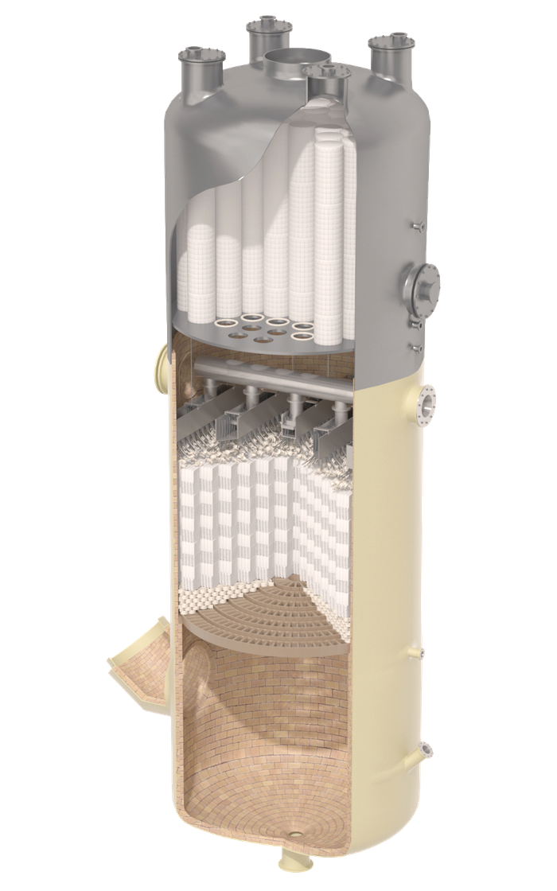
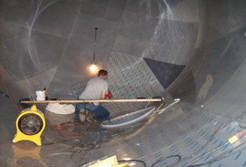
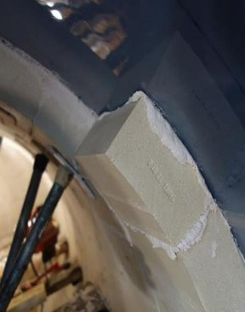
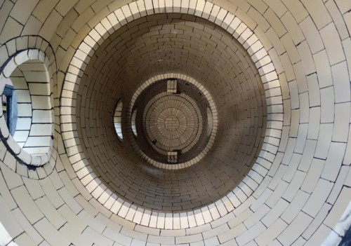
Key features and purpose
Acid Brick Lined Vessel with Carbon Steel shell and PVDF membrane
Acid Brick Lined Quench Vessel
Sulfuric Acid tower

Slide 11
Key features and purpose
Category | Monolithic Refractories | Refractory Brick | Chemical-Resistant Masonry
Primary Purpose | Withstand high temperatures, thermal shock, mechanical load | Structural thermal protection with stable geometry and erosion resistance. | Resist corrosive chemicals, permeation, and liquid attack.
Design Drivers | Heat flux, thermal gradients, expansion allowance, moisture removal. | Thermal expansion, structural keying, compression. | Chemical concentration, pH, temperature of chemical exposure, membrane. Mortar& brick compatibility.
Service Environment | Extreme heat, rapid cycling, mechanical load. | High temperature environment; chosen when stability or shape retention is critical. | Corrosive, chemical-laden liquids/vapors.
Material Behavior | Moisture release leading to steam pressure; expansion/shrinkage. | Controlled expansion through joints; mechanical interlock. | Chemical impermeability and membrane & mortar resistance dominate performance.

Slide 12
Key features and purpose
Category | Monolithic Refractories | Refractory Brick | Chemical-Resistant Masonry
Installation Technique | Controlled mixing, water addition, vibration, curing. | Precise bricklaying, joint control, keying, soldier courses. | Bedding/jointing mortars (furan, epoxy, silicate), membrane systems.
Anchoring / Support | Heavy use of anchors to restrain material. | Rarely anchored; relies on geometry and compression. | No anchors; relies on joint integrity and membranes.
Tolerances & Expansion | Requires expansion joints, slip planes, tight control to avoid spalling. | Tight joint tolerance, alignment, keying patterns, compression rings. | Joint uniformity essential; expansion less critical.
Dry-Out / Conditioning | Mandatory dry-out + controlled heat-up. | No dry-out as brick linings are installed dry or with minimal mortar; controlled heat-up still required. | No heat-up; controlled curing of resin mortars.

Slide 13
Key features and purpose
Category | Monolithic Refractories | Refractory Brick | Chemical-Resistant Masonry
QA Focus | Density, water content, curing, anchorage, thermal zoning. | Joint thickness, alignment, keying, brick quality. | Joint integrity, mortar, brick & membrane compatibility, membrane pinhole-free , membrane continuity.
Common Failure Modes | Steam spalling, thermal shock, erosion. | Misalignment, joint opening, keying failure. | Chemical attack, joint failure, permeation.

Slide 14
Summary of Differences
Primary challenge handling extremely high temperatures versus high chemical corrosion.
Key materials Fireclay, Hi-alumina. Magnesia bricks, castable materials, Silica bricks versus specific acid-proof bricks, mortars and chemical resistant membrane systems.
Installation focused on thermal efficiency and structural integrity at high heat versus impermeable chemical resistant barrier and corrosion barrier.
While some large industrial service companies may employ craftsmen with both skill sets for complex projects like those in acid plants that involve both high heat and corrosive conditions, the skills required for each application are distinct and specialized.

Slide 15
Knight Material Technologies
5385 Orchard View Drive
East Canton, OH 44730
www.knightmaterials.com
• Philip Hypes
• Gulf Coast Regional Opporations Manager
• O: +1 234-901-1755 C: +1 330-224-0486
• E: Philip.hypes@knightmaterials.com

